Slide 1
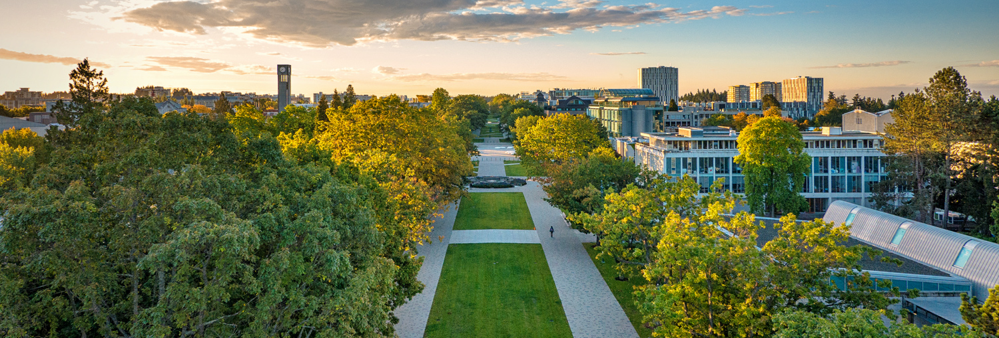
Opportunities in Business Research
Ch’nook Scholars Program
David J. Hardisty, Associate Professor & Division Chair
Marketing & Behavioural Science

Slide 2

Agenda
Business research examples
Academic research: Pros & cons
“Typical” career pathway
How to get started

Slide 3
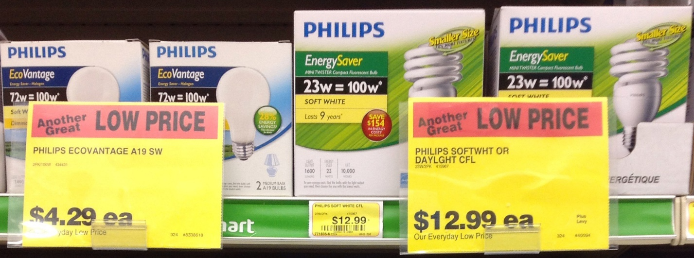
How to solve the “energy efficiency paradox”?
12%
chose efficient option

Slide 4
Why does this happen?
Most consumers aren’t thinking about energy costs when shopping
Most consumers take a short-term perspective
Most consumers don’t care about future energy savings
The solution: 10-year dollar cost labeling

Slide 5
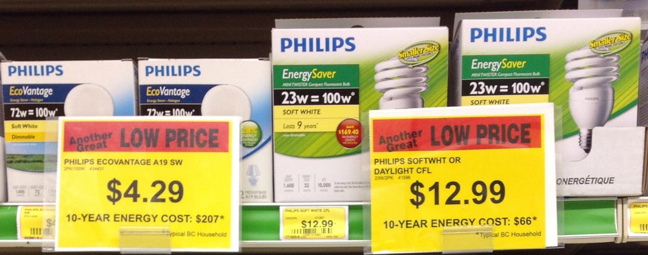
How to solve the “energy efficiency paradox”?
12%
chose efficient option
48%
chose efficient option

Slide 6
Research Areas
Consumer Behaviour
Organizational Behaviour & HR
Operations & Logistics
Economic modeling
Accounting
Finance

Slide 7
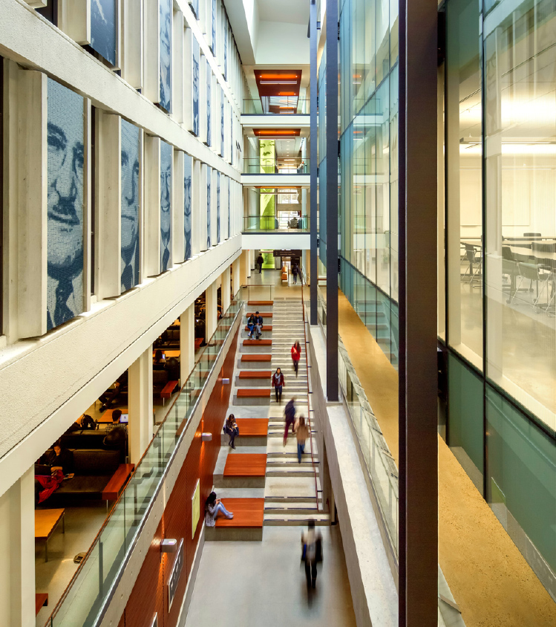
Academic Research: Pros
Serve truth and the public good
Self-directed
Interesting & varied work
(Research, teaching, & service.)
Flexible schedule
Good salary

Slide 8
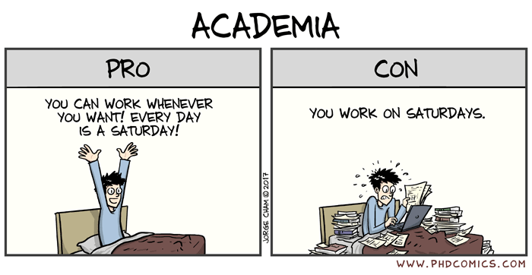
Notes:
Phtoto Credit: Global Development Institute – Jorge Cham

Slide 9
Academic Research: Cons
Work-live balance is an issue
Lots of failure, criticism, and rejection
(but: you can always try again)
Rewards are delayed
Need to be self-motivated
Low job supply; often requires moving

Slide 10
“Typical” academic research pathway
Work as a research assistant (paid!) or do an independent research project
Work in business or government for a few years
Find an academic research mentor
Sit in on a PhD research seminar and/or attend talks at conferences, etc.
(Optional: do a masters degree)
Do PhD: fully funded, some classes, mostly research
(Optional: do a post-doc)
Work as Assistant Professor or transition to an industry research position

Slide 11
Next steps
Want to work as a research assistant? Email me! david.hardisty@sauder.ubc.ca
Browse faculty research profiles and “cold call” them to see if they are currently accepting RAs
Already graduated? Consider our Behavioural Insights certificate program: https://continuingstudies.sauder.ubc.ca/programs/behavioural-insights
(full scholarship available for one Indigenous student!)
Want to attend research talks? Email me!
Also, feel free to add me on LinkedIn:
https://www.linkedin.com/in/david-hardisty/

Slide 12
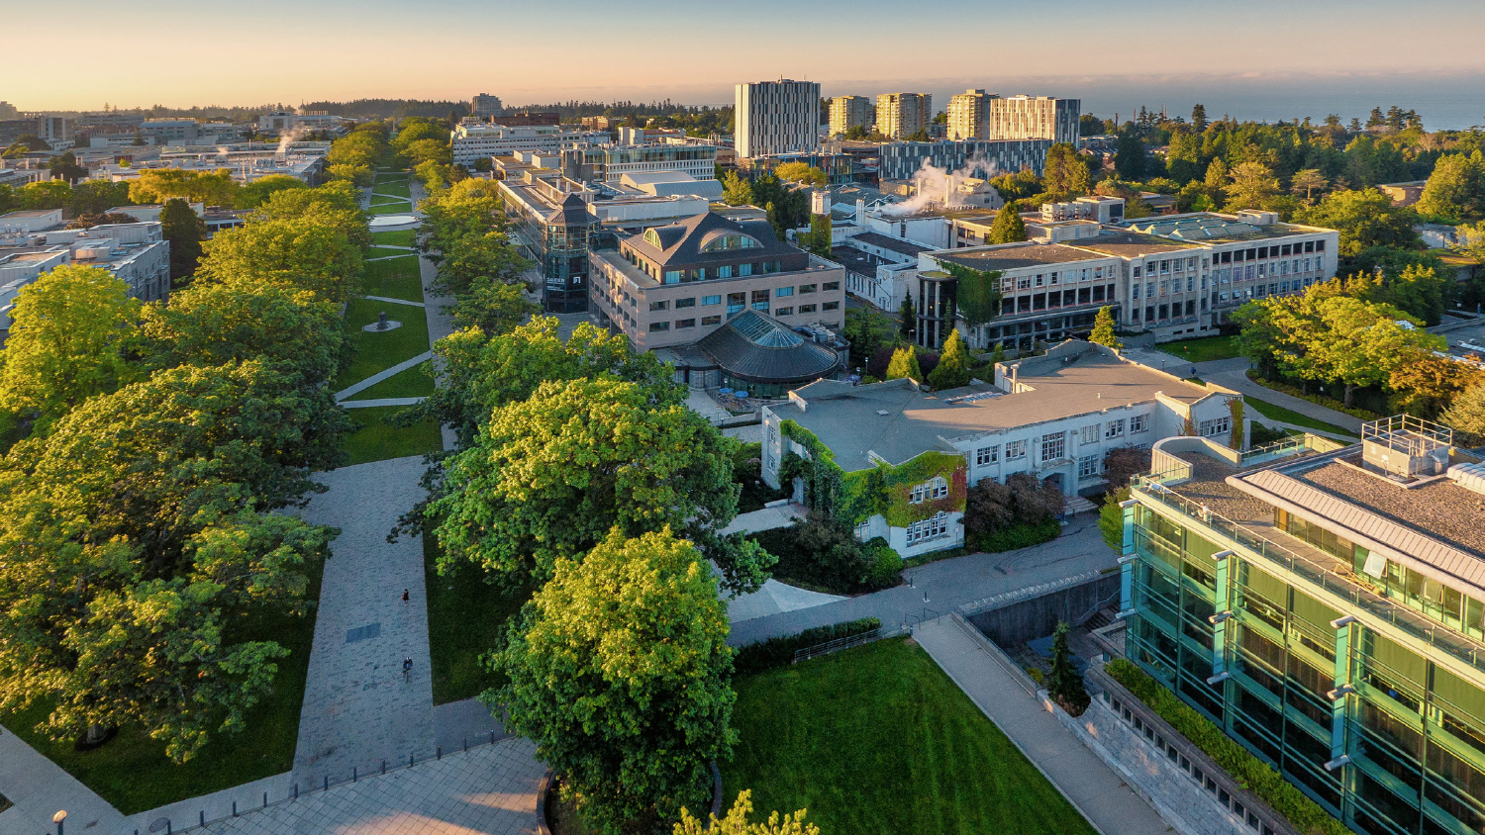
Thank you!
What questions do you have???

